Slide 1
Habit tracker for young people
Jaroslava Otmanová

Slide 2
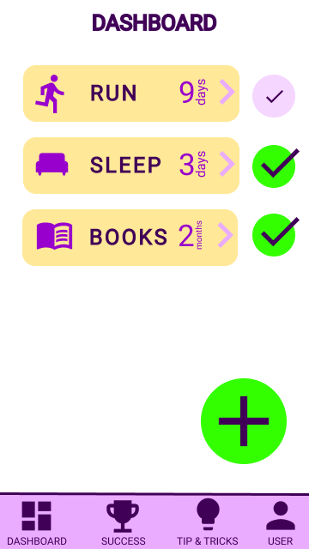
Project overview
The product:
Habit tracker is meant to help young people with keeping and maintaining habits. They can see they progress and read tips how to manage to keep habits.
Preview of selected polished designs.
Project duration:
12/2021 - 03/2022

Slide 3
Project overview
The problem:
Young people wants to keep healthy habits and they need or want help with tracking their habit and see success with keeping that habit.
The goal:
Help young people keep interest in healthy habits and track success with maintaining the habits they want to hold.

Slide 4
Project overview
My role:
UX researcher, UX designer
Responsibilities:
Research, design

Slide 5
User research
Personas
Problem statements
Competitive audit
Ideation
Understanding
the user

Slide 6
User research: summary
Firstly I did interviews with users. Based on the interviews I extracted the basic needs of the user when keeping and tracking habits. This showed more insights than were assumed at the beginning of the research. Such as need of reminder or wanting to check daily progress..

Slide 7
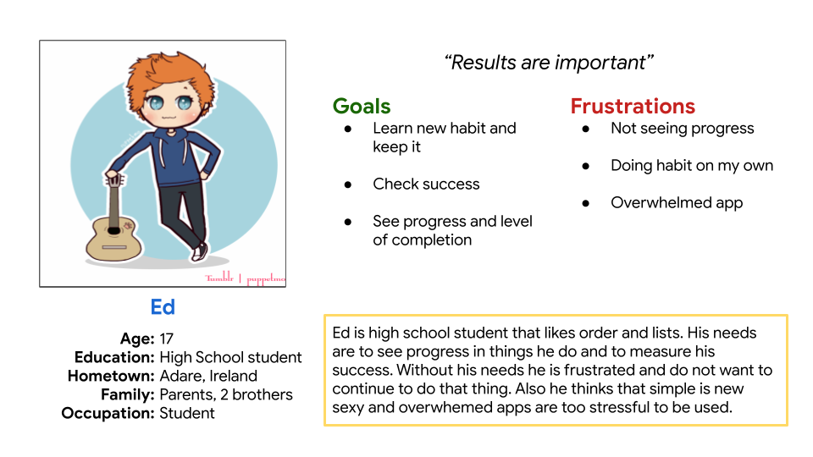
Persona 1: Ed
Problem statement:
Ed is a list loving person who needs to check tasks and to check successfully done tasks because he wants to see progress in his learning path.

Slide 8
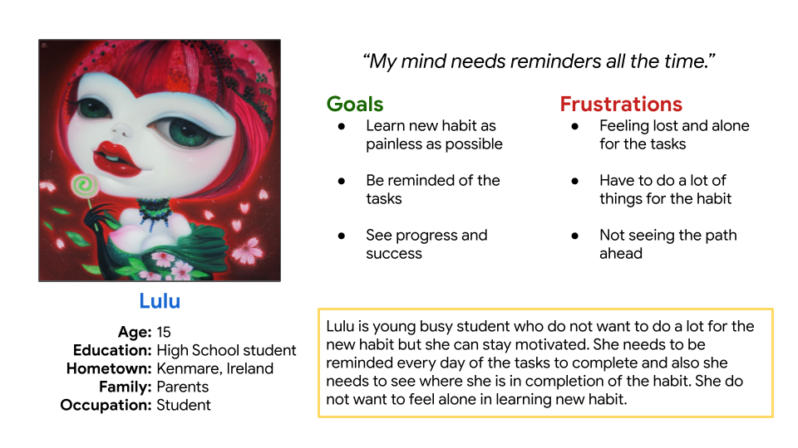
Persona 2: Lulu
Problem statement:
Lulu is a busy student who need to be reminded to do the tasks in the learning process because she wants to complete the tasks and continue in the learning process.

Slide 9
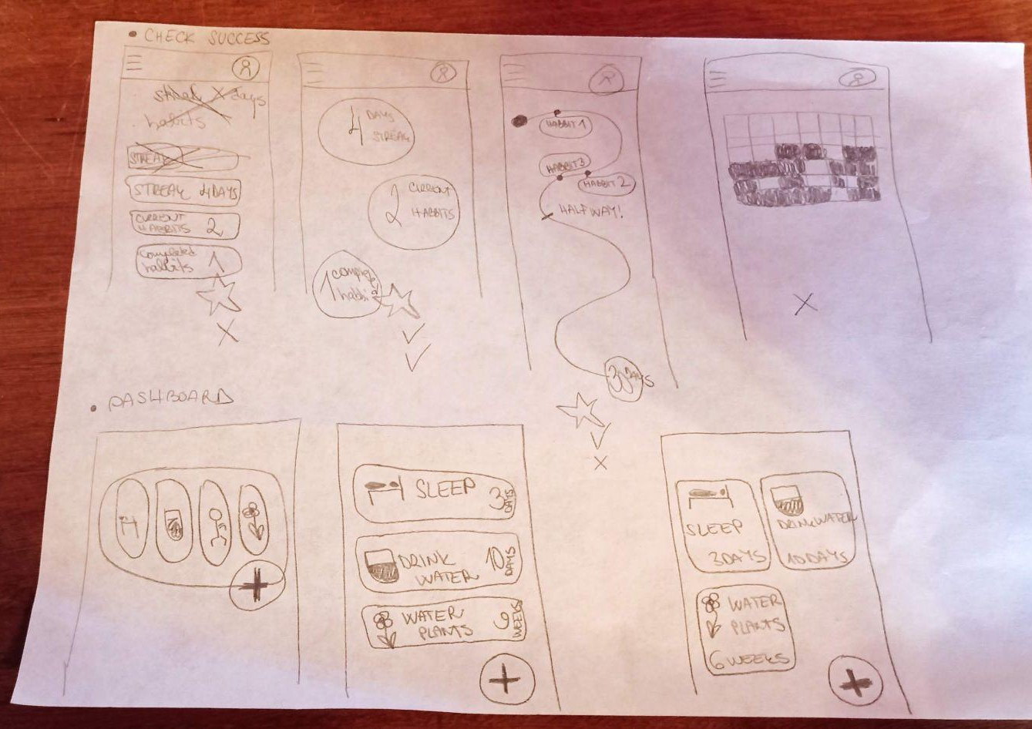
Ideation
Main goal for ideation phase was to determine how to make components for each function and it could be used for both mobile app and website.
Image of ideation exercise

Slide 10
Digital wireframes
Low-fidelity prototype
Usability studies
Starting
the design

Slide 11
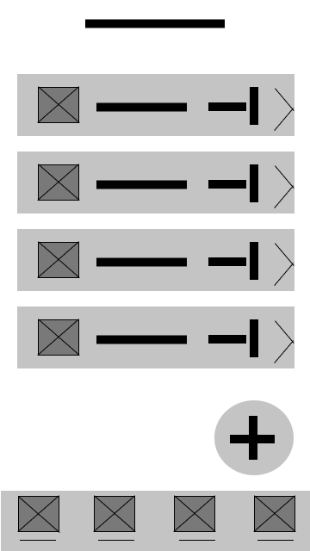
Digital wireframes
Digital wireframes
List of habits on main dashboard
Main page is the dashboard with list of habits with checking mechanism and a way to detail of the habit.
Main changes at this stage was the brightening the way to detail of the habit and making the add button more clear and more bright.
Add new habit on main dashboard to be quick in adding

Slide 12
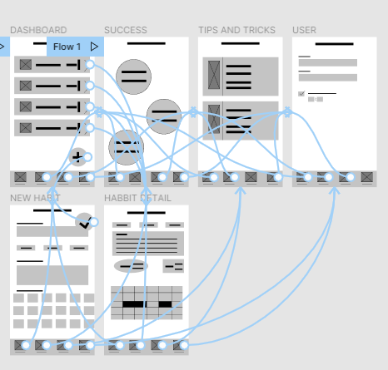
Low-fidelity prototype
Mobile app
Web application
Screenshot of prototype with connections or prototype GIF

Slide 13
Usability study: parameters
Study type:
Unmoderated usability study
Location:
Czech republic, remote
Participants:
5 participants
Length:
30-60 minutes

Slide 14
Usability study: findings
1
2
3
Way to habit detail
Add new habit button
Tab navigation icons
The navigation to habit detail was unclear and needed to be more clear. Adding arrow for navigation did the job.
Button for adding new habit was unclear. It needed to be more clarified, brghter and more visible
Just icons for tab navigation was unclear and the text was needed to add.

Slide 15
Refining
the design
Mockups
High-fidelity prototype
Accessibility

Slide 16
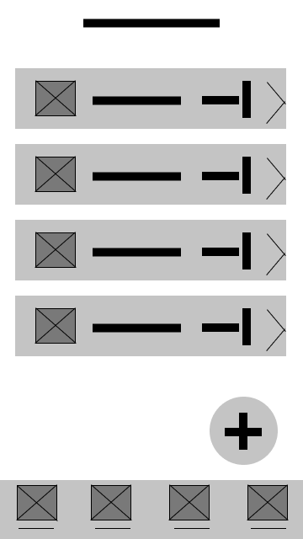
Mockups
Before usability study
After usability study
Based on usability study I better visualize the navigation to the habit detail and add the checking button for progress on the habit.
Mockup 1 before
Mockup 1 after

Slide 17
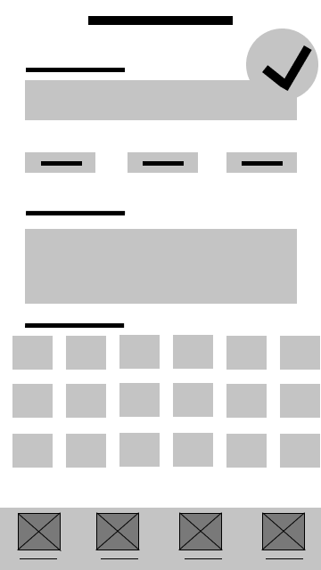
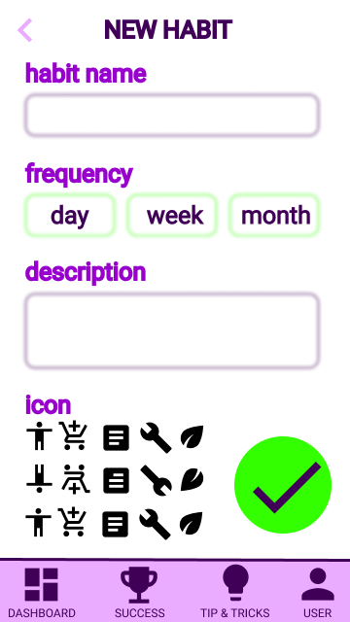
Mockups
Before usability study
After usability study
The save new habit button was placed in not suitable place so in mockup, it was changed. Also in wireframe there was luck of the way going back to the dashboard along the tab navigation so the top left arrow as the back button was added.
Mockup 2 before
Mockup 2 after

Slide 18
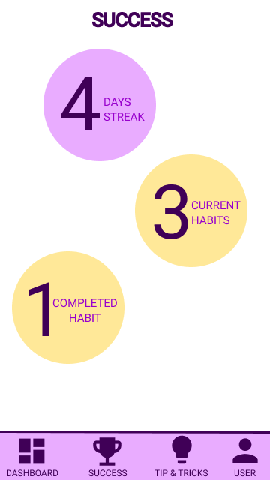
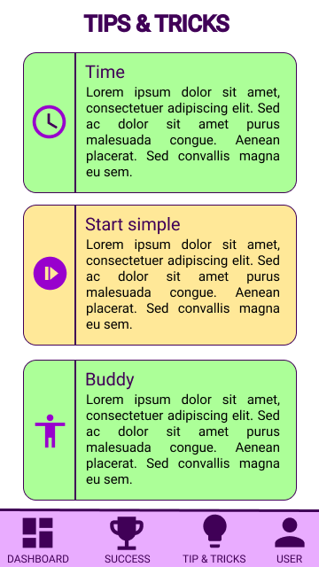
Mockups
Main mockup screen for display
Main mockup screen for display
Main mockup screen for display
Main mockup screen for display

Slide 19
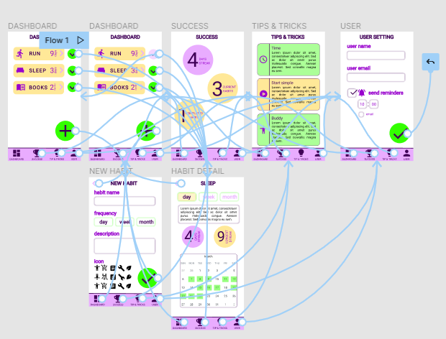
High-fidelity prototype
mobile app
website
Screenshot of prototype with connections or prototype GIF

Slide 20
Accessibility considerations
1
2
3
Provided access to users who are vision impaired through adding alt text to images for screen readers.
Used icons to help make navigation easier.
Used images and sounds to better present the content.

Slide 21
Going forward
Takeaways
Next steps

Slide 22
Takeaways
Impact:
Young people tend for technologies so keeping healthy habits through phone is great way to stay positive and healthy. There are number of healthy habits such as enought sleep, drinking water regularly, reading books, jogging or going for a ride which can positively impact the life of young people.
What I learned:
I have learned that making design for mobile app and responsive website is a very long process which cannot be done in a short time. The process of making a complex and workng design needs time and lots of angles of view.

Slide 23
Next steps
1
2
3
I would again conduct a usability study with a slightly different group of people and seek for more ideas to improve the function of the app.
Make some progress on success page and how to turn that page on a standing stone of the app.
Make the user setting more powerful for the user.

Slide 24
Insert a few sentences summarizing the next steps you would take with this project and why. Feel free to organize next steps in a bullet point list.
Let’s connect!
Thank you for your time reviewing my work on the Habit tracker app! If you’d like to see more or get in touch, my contact information is provided below.
Email: j.otmanova@gmail.com

